Slide 1
 | Age (yrs) | Gender | Education (yrs) | MoCA
Younger Adults (n=31) | 23.65 (2.86) | 54.80% female (n=17) | 15.90 (2.27) | N/A
Older Adults (n=27) | 73.44 (7.06) | 51.90% female (n=14) | 15.30 (3.69) | 28.11 (1.01)
Data from first 8 blocks used consistently across block and trial-level analyses.

Slide 2
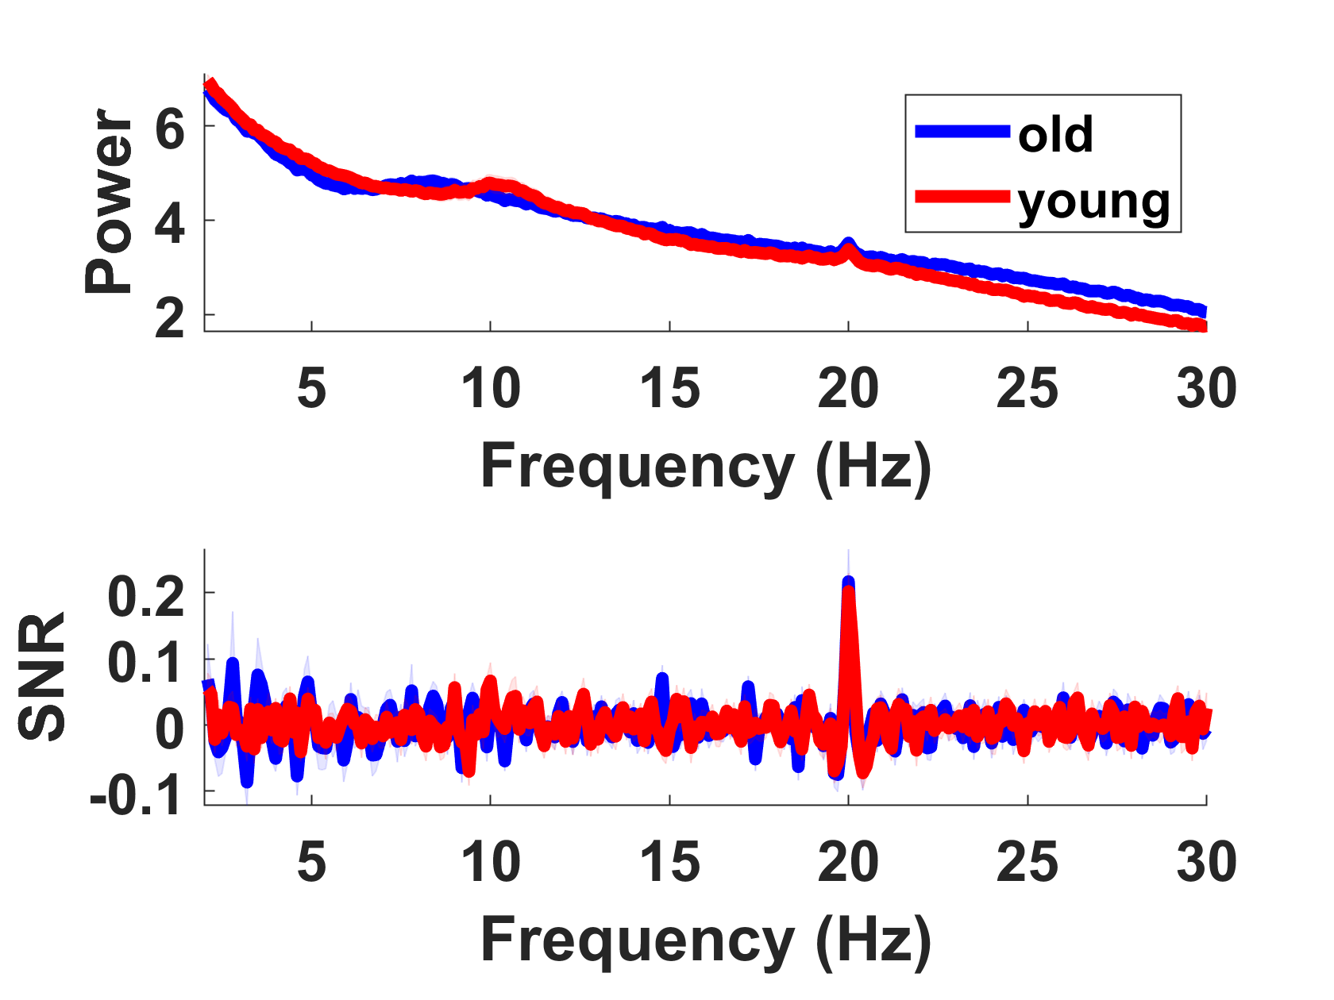
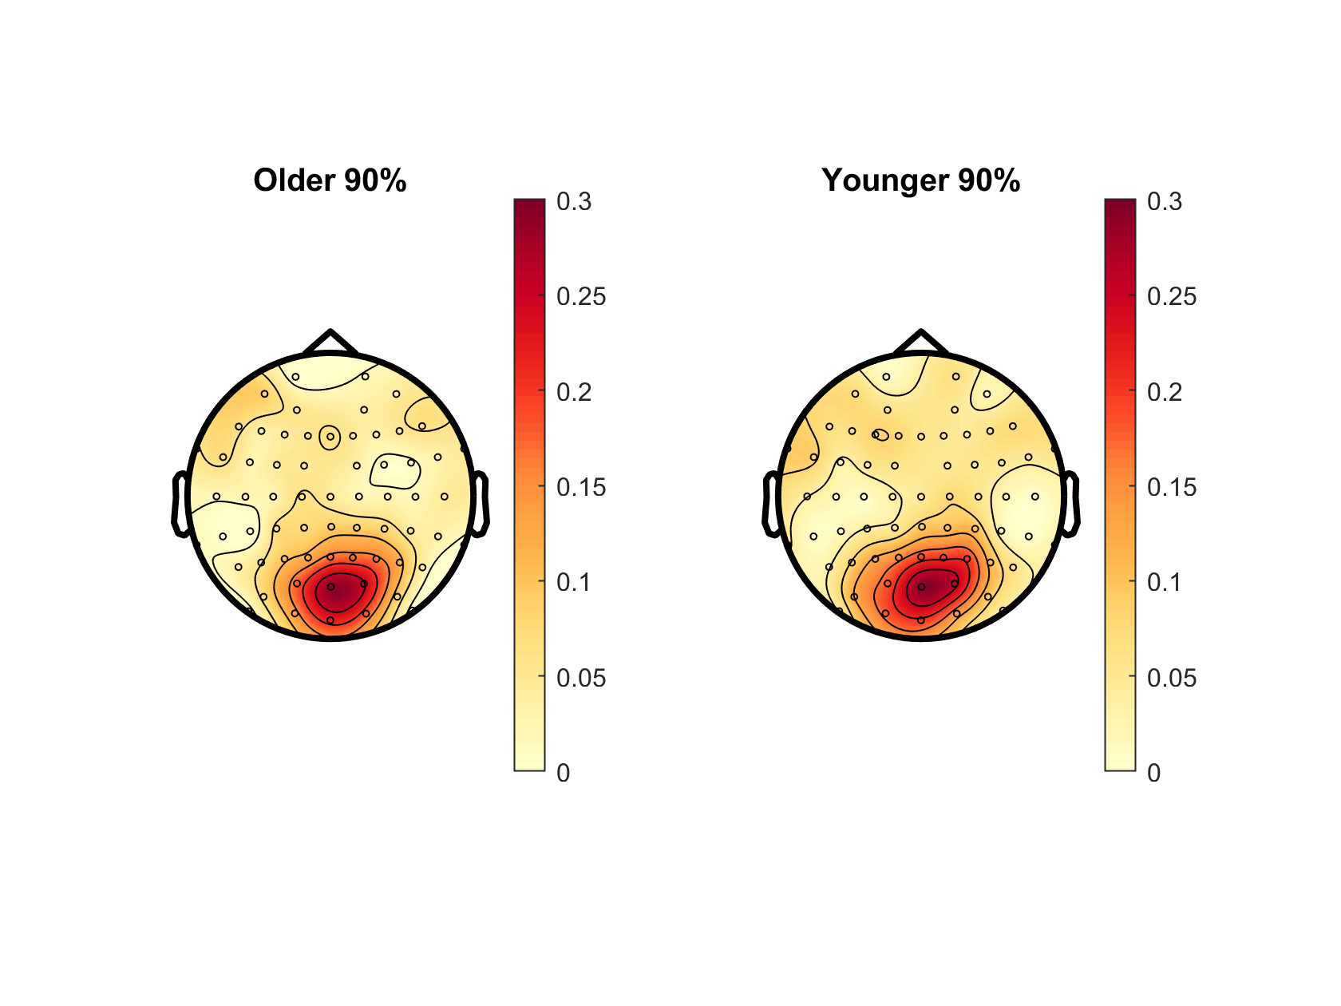
Notes:
? Slightly different to Oz PSD in plotPowerSpec script

Slide 3
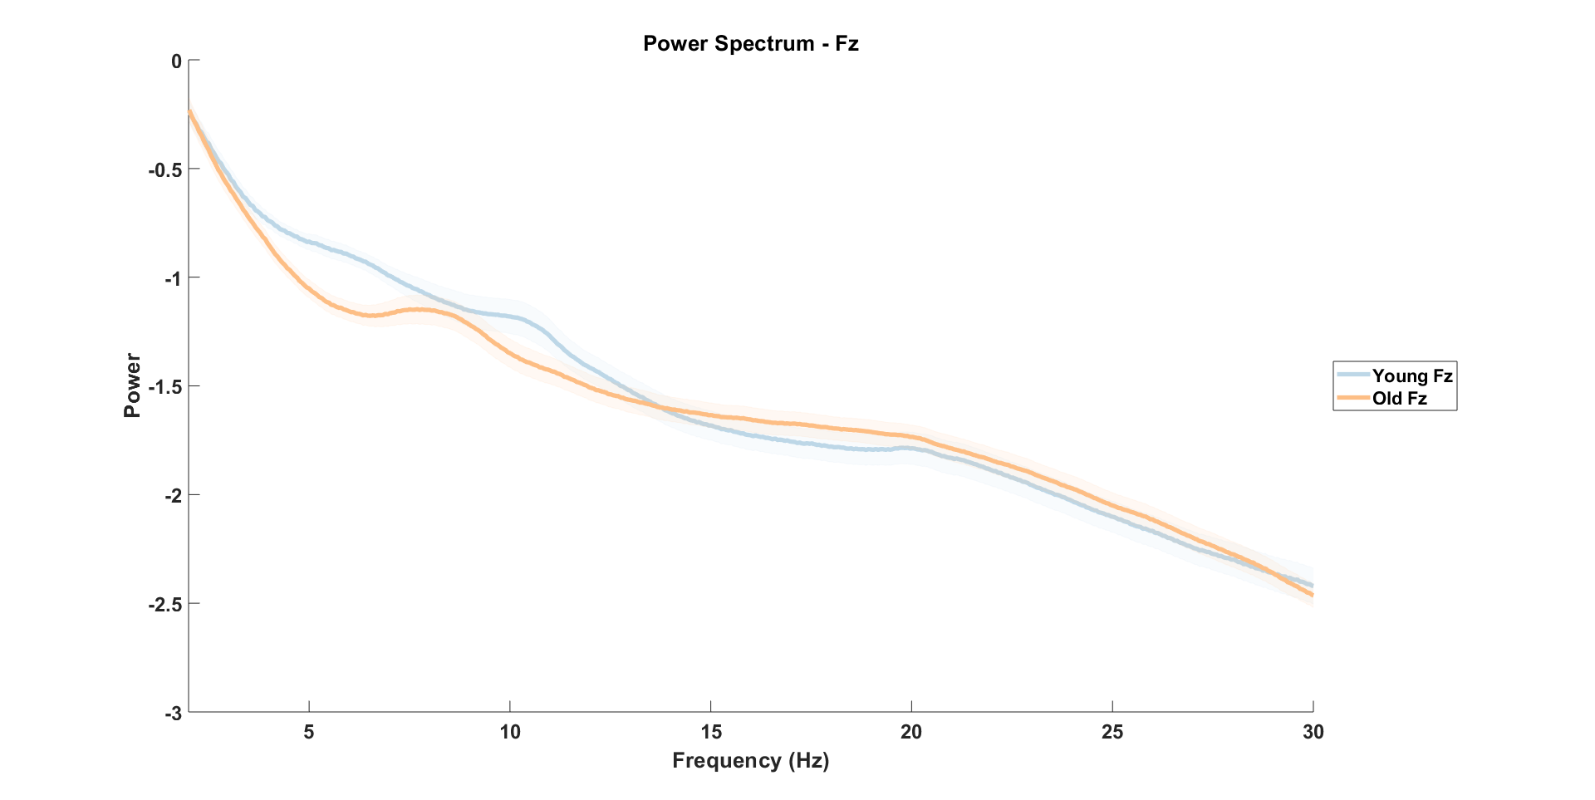

Slide 4
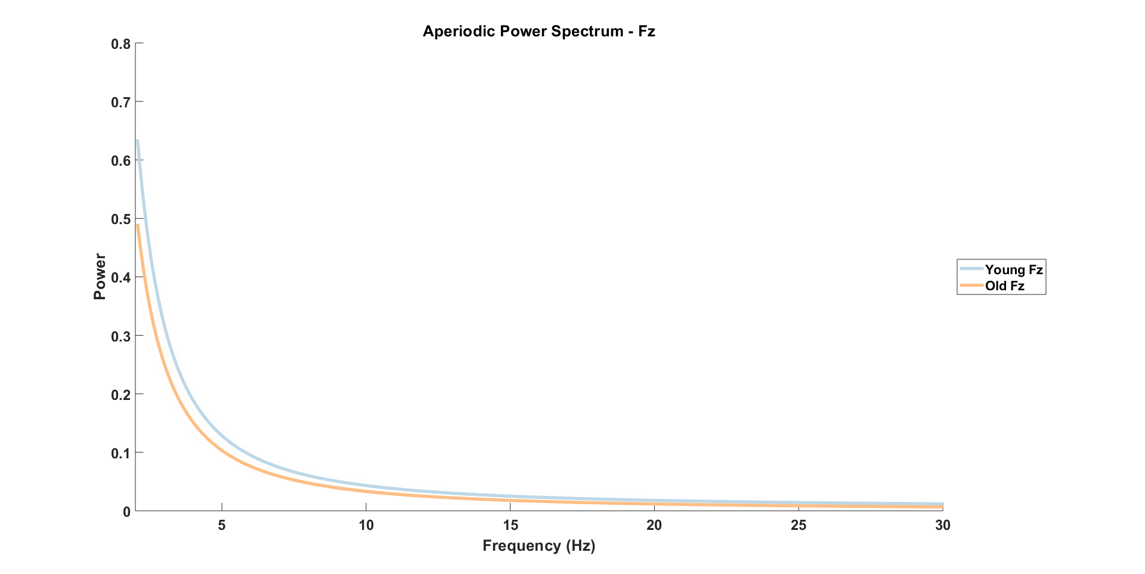

Slide 5
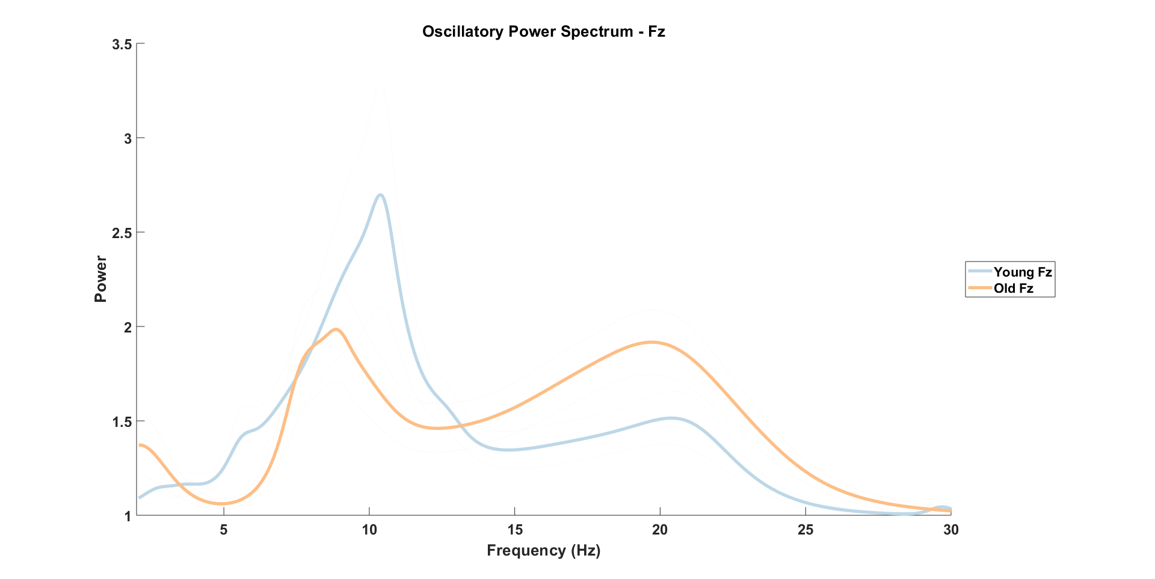

Slide 6
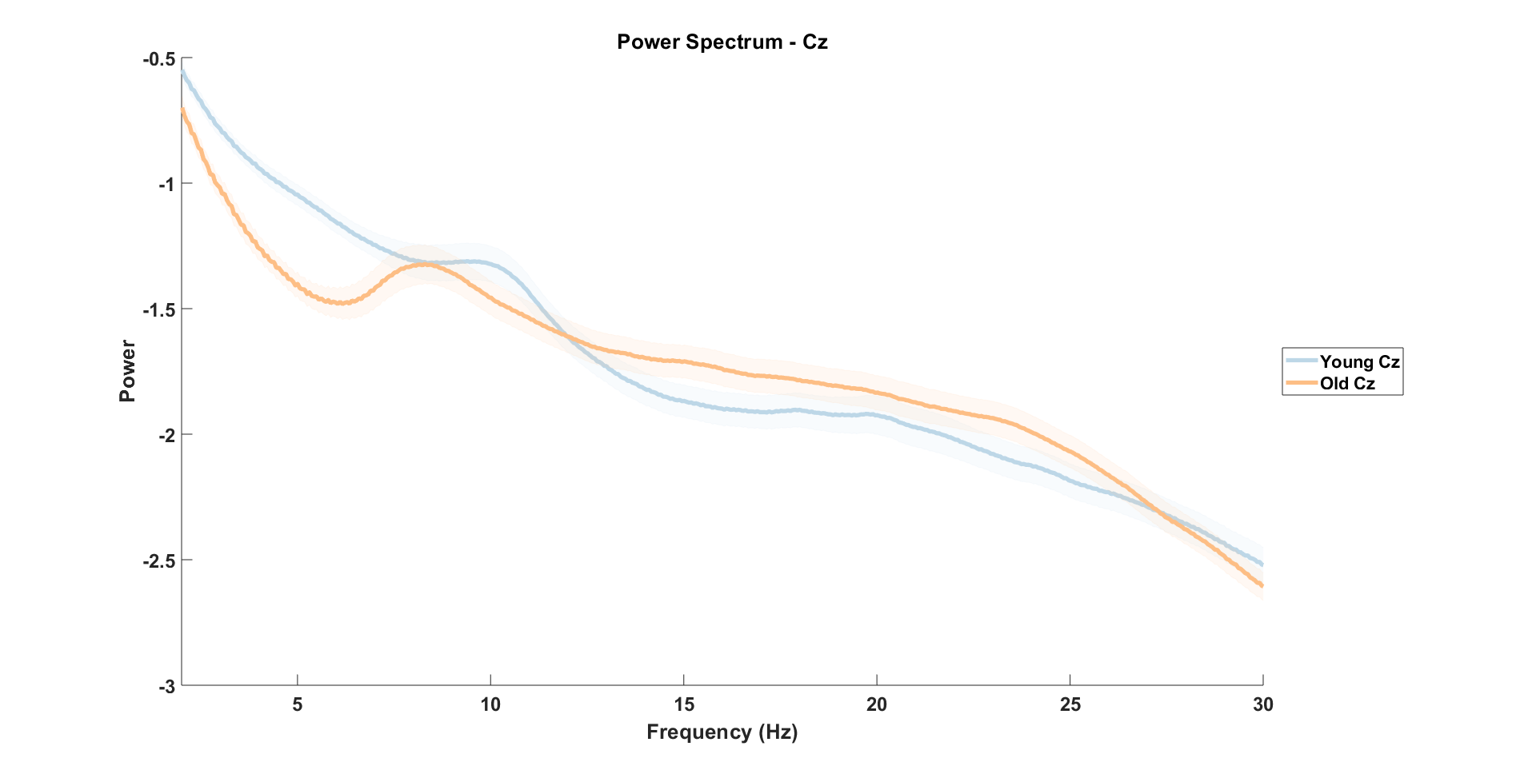

Slide 7
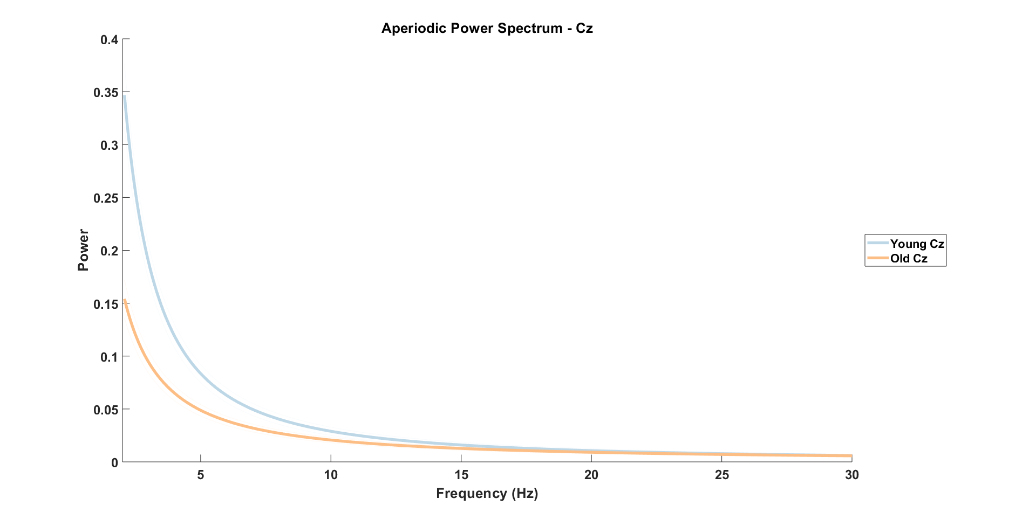

Slide 8
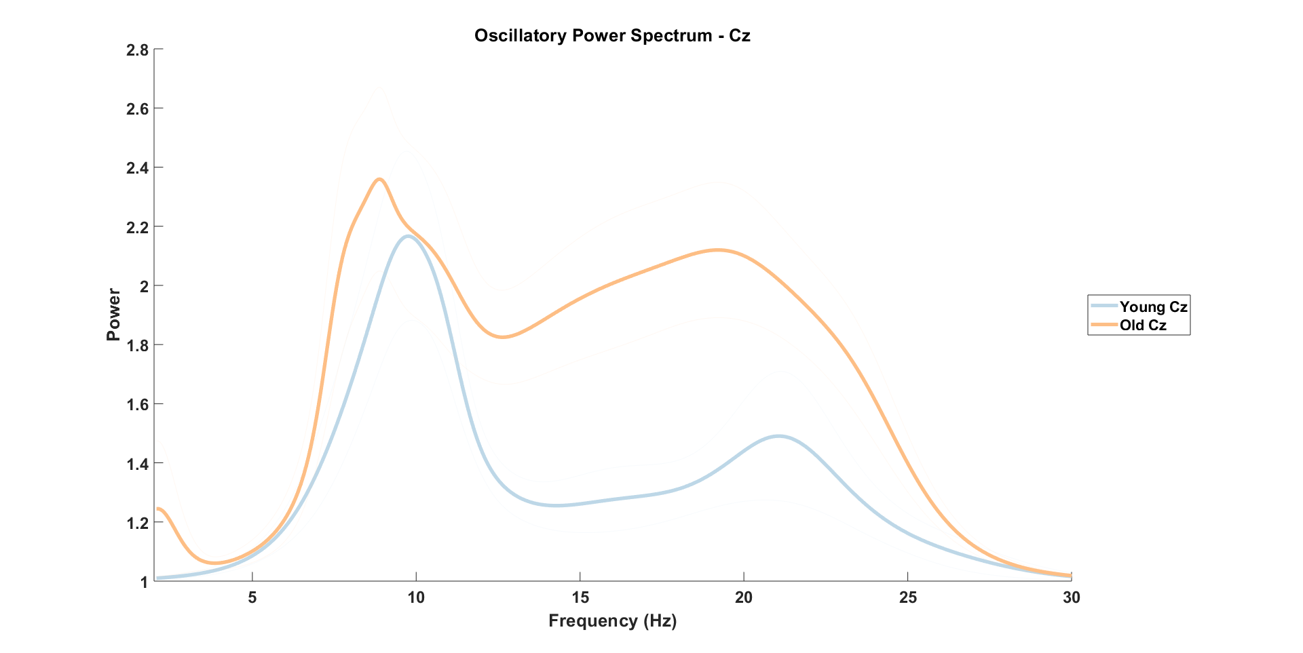

Slide 9
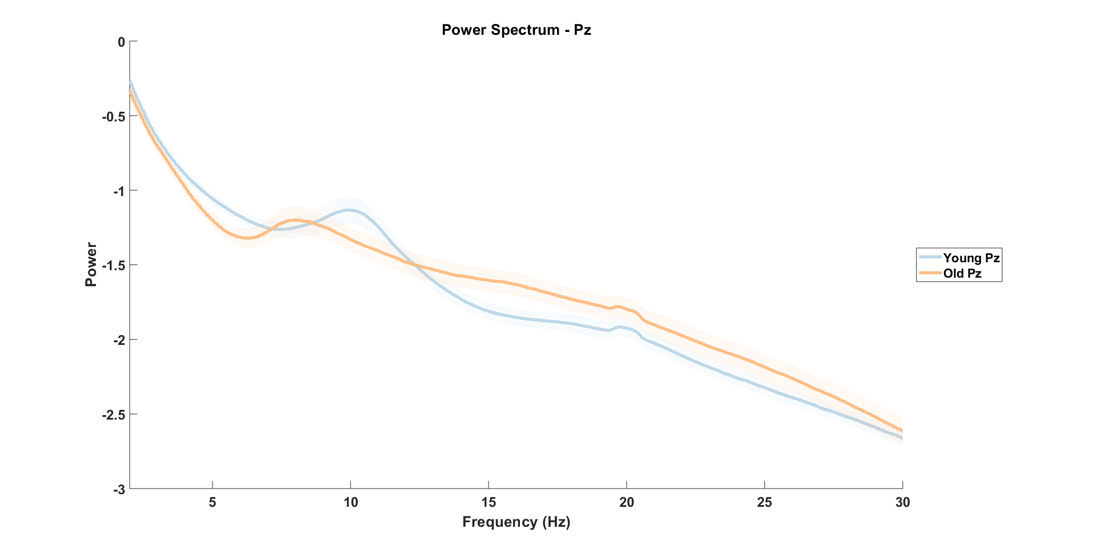

Slide 10
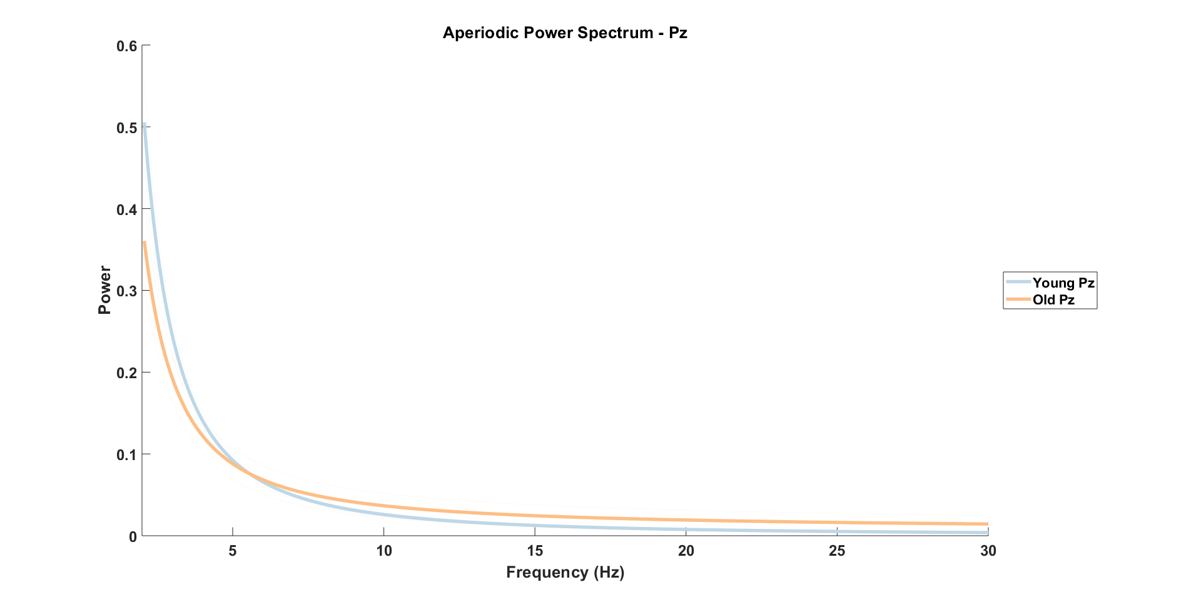

Slide 11
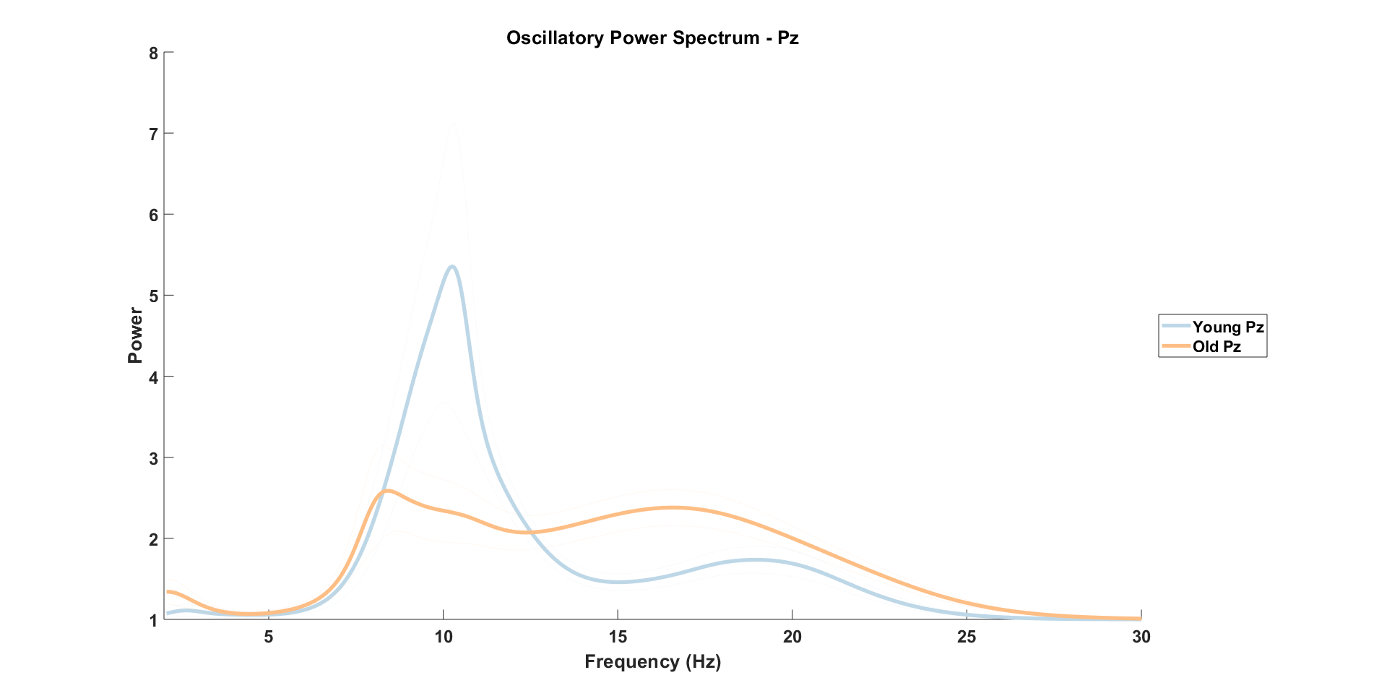

Slide 12
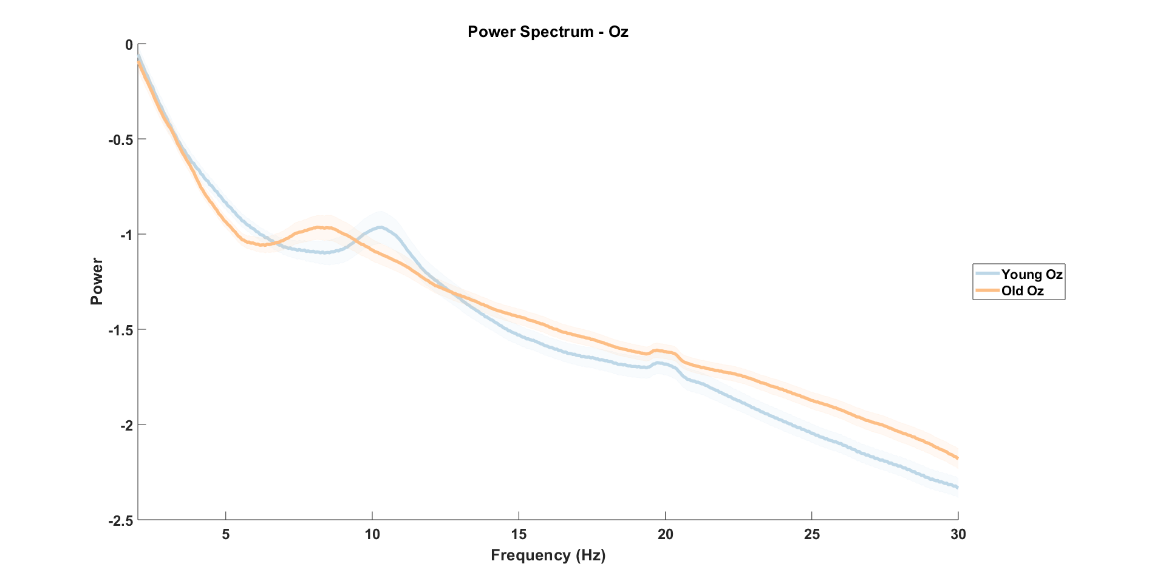

Slide 13
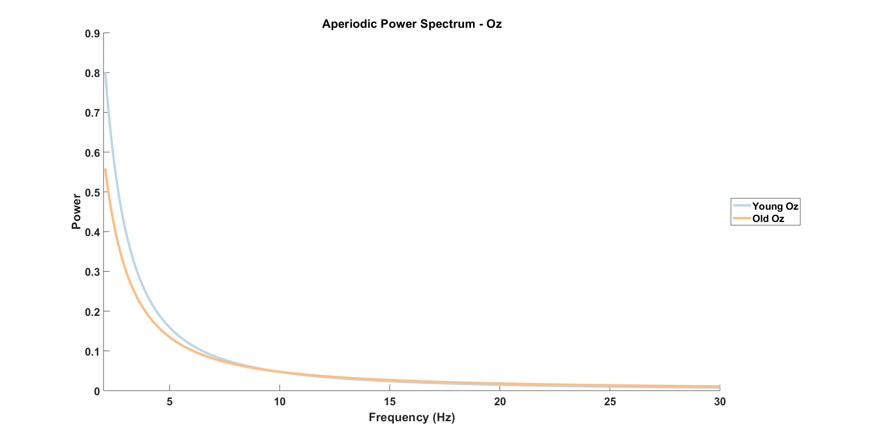

Slide 14
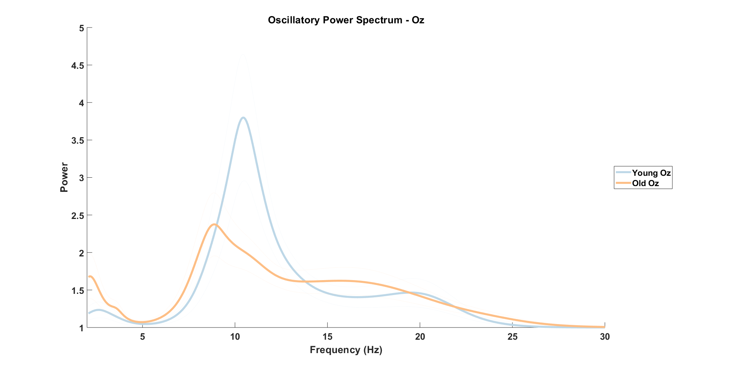

Slide 15
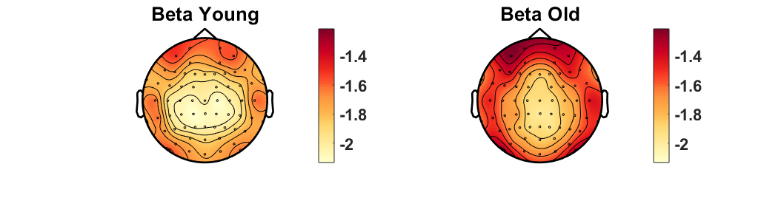
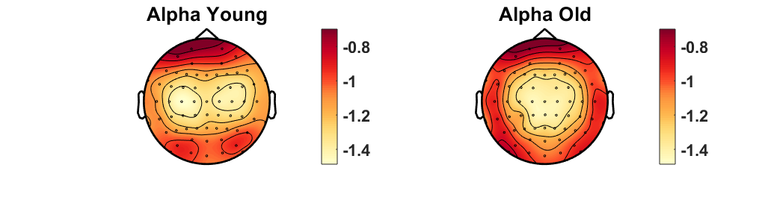
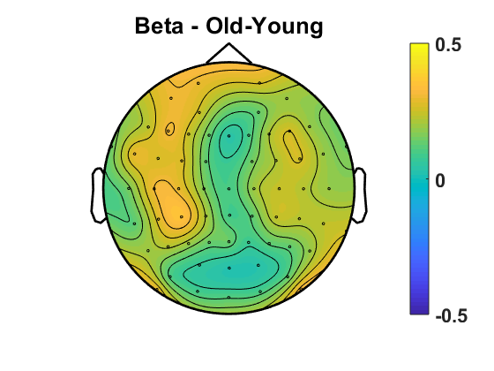
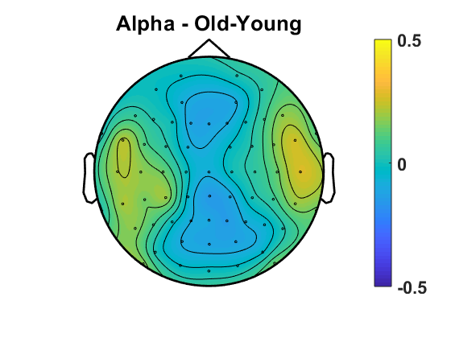
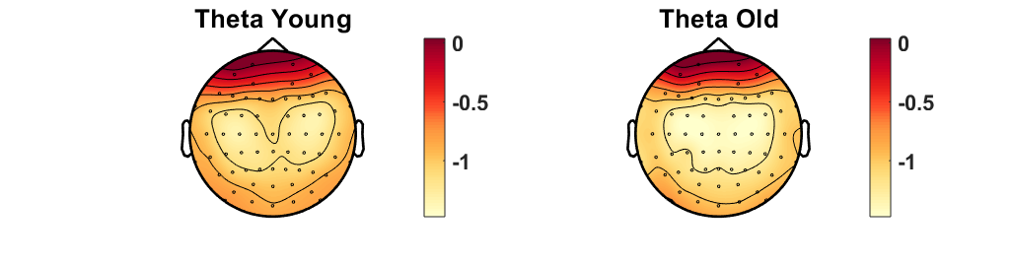
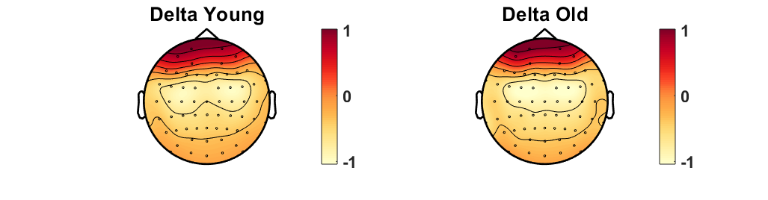
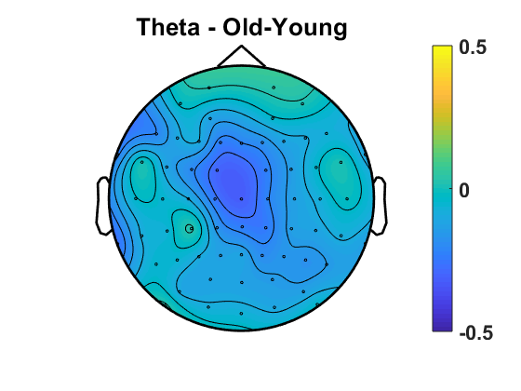
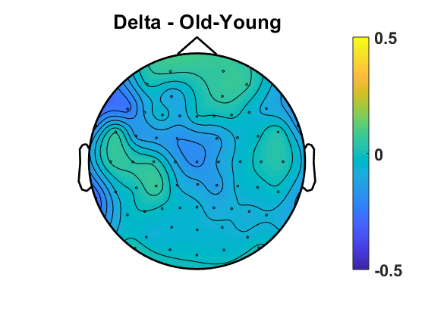
Power
No sig difference in Oz/((O1+O2)/2) ratio
p=.95
Notes:
REPLICATE TOPOGRAPHIES with all_osci (new scripts) – DONE (next slide)
+ differences old-young for each freq band - DONE

Slide 16
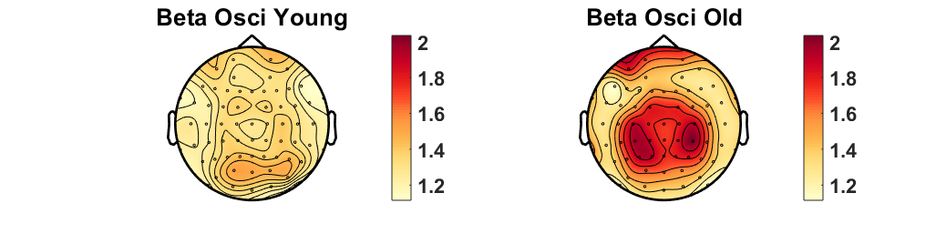
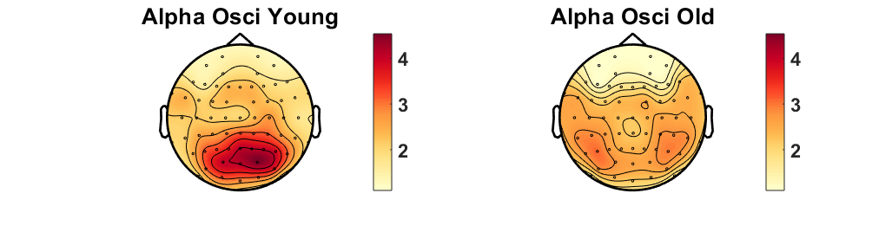
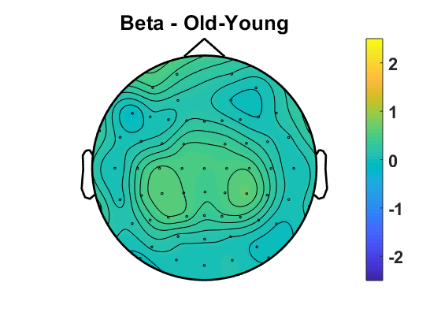
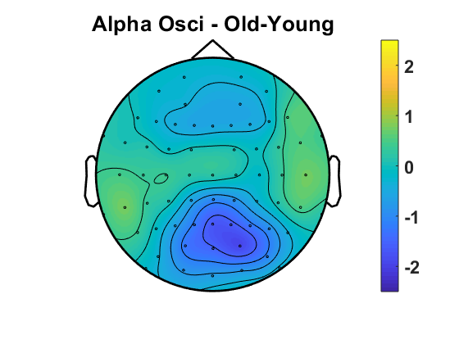
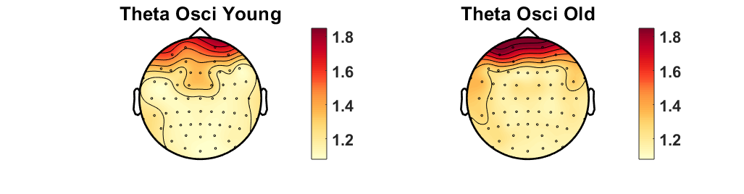
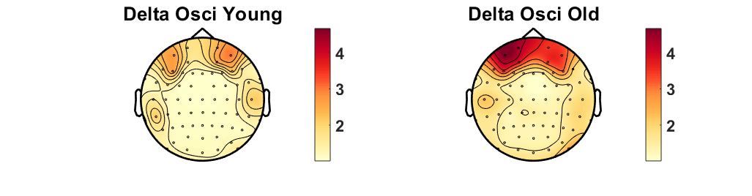
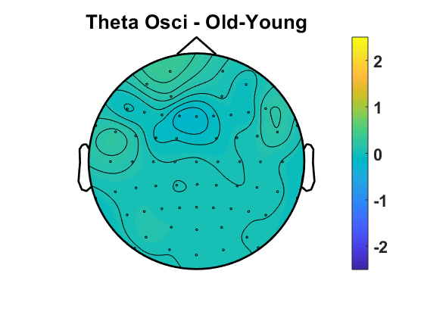
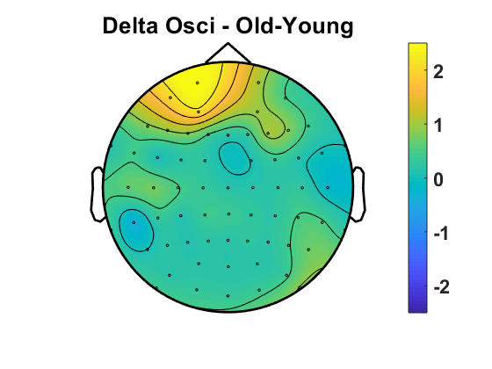
Oscillatory Component
No sig difference in Oz/((O1+O2)/2) ratio
p=.69
Notes:
REPLICATE TOPOGRAPHIES with all_osci (new scripts) – DONE (next slide)
+ differences old-young for each freq band - DONE

Slide 17
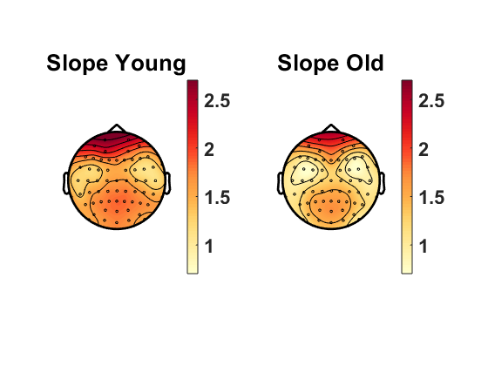
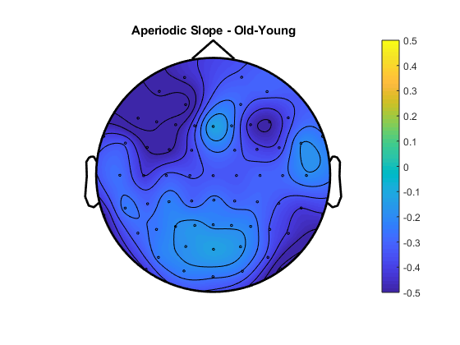
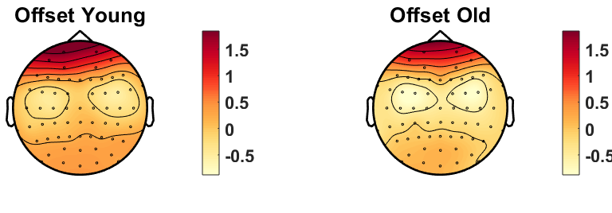
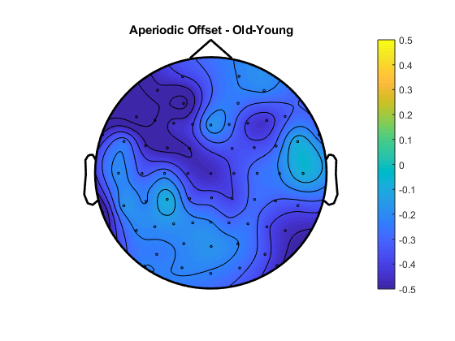
Aperiodic Slope – Younger 90% vs Older 90%
Aperiodic Offset – Younger 90% vs Older 90%
Notes:
Add old-young difference topograpjy - DONE

Slide 18
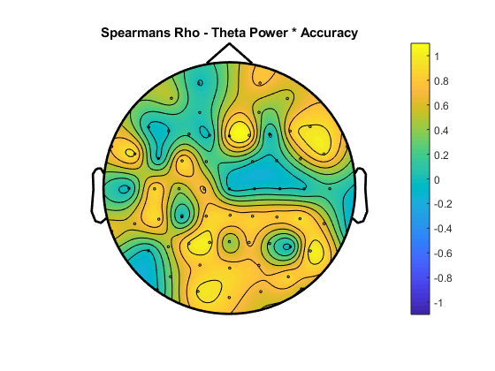
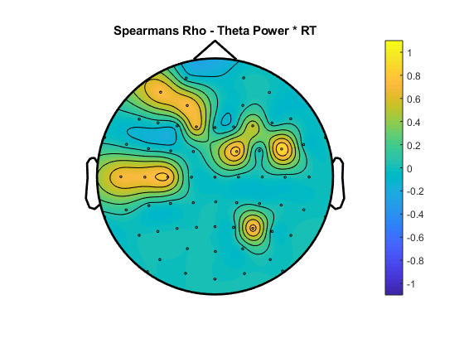
Oscillatory Theta x Behaviour

Slide 19
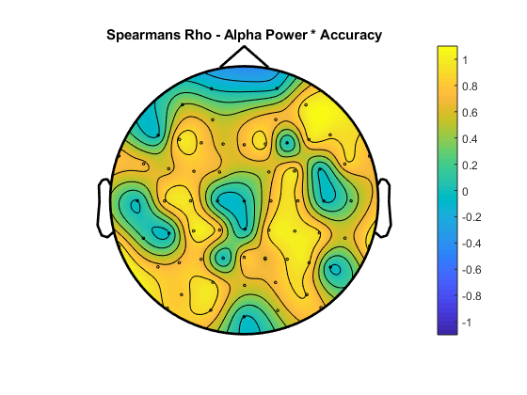
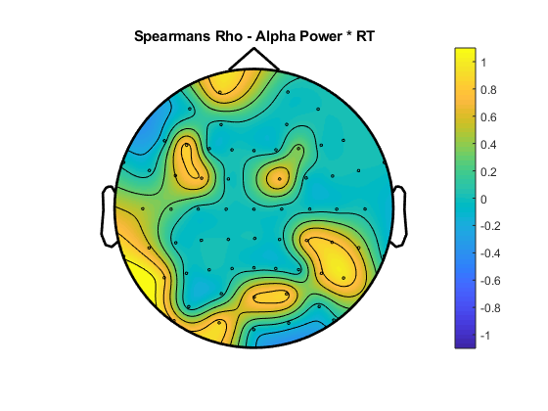
Oscillatory Alpha x Behaviour

Slide 20
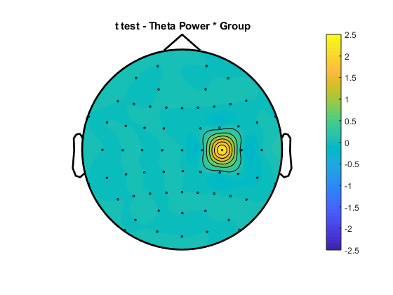
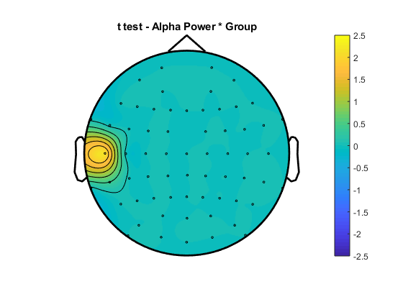
Group Oscillatory Differences

Slide 21
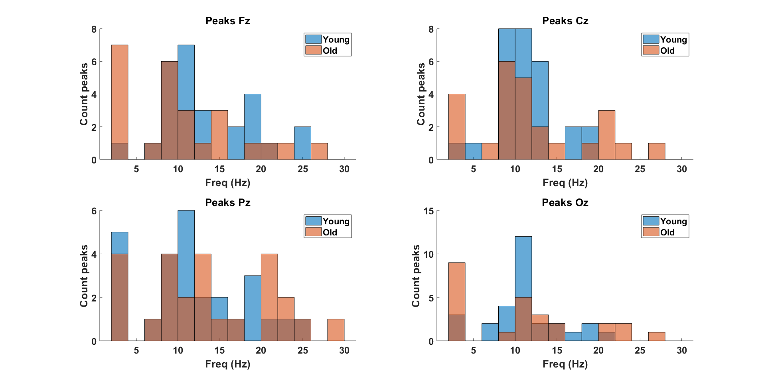
OLD SETTINGS

Slide 22
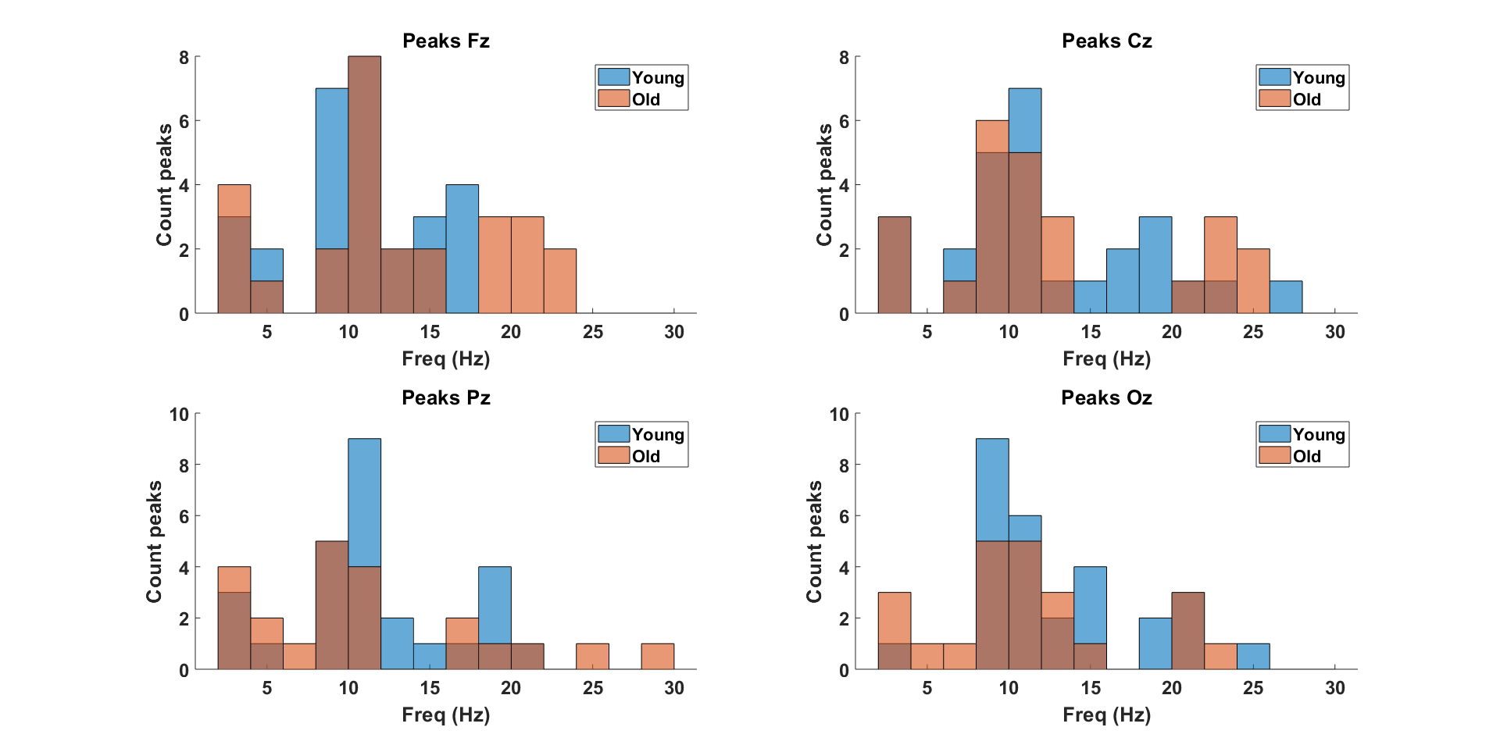
NEW SETTINGS

Slide 23
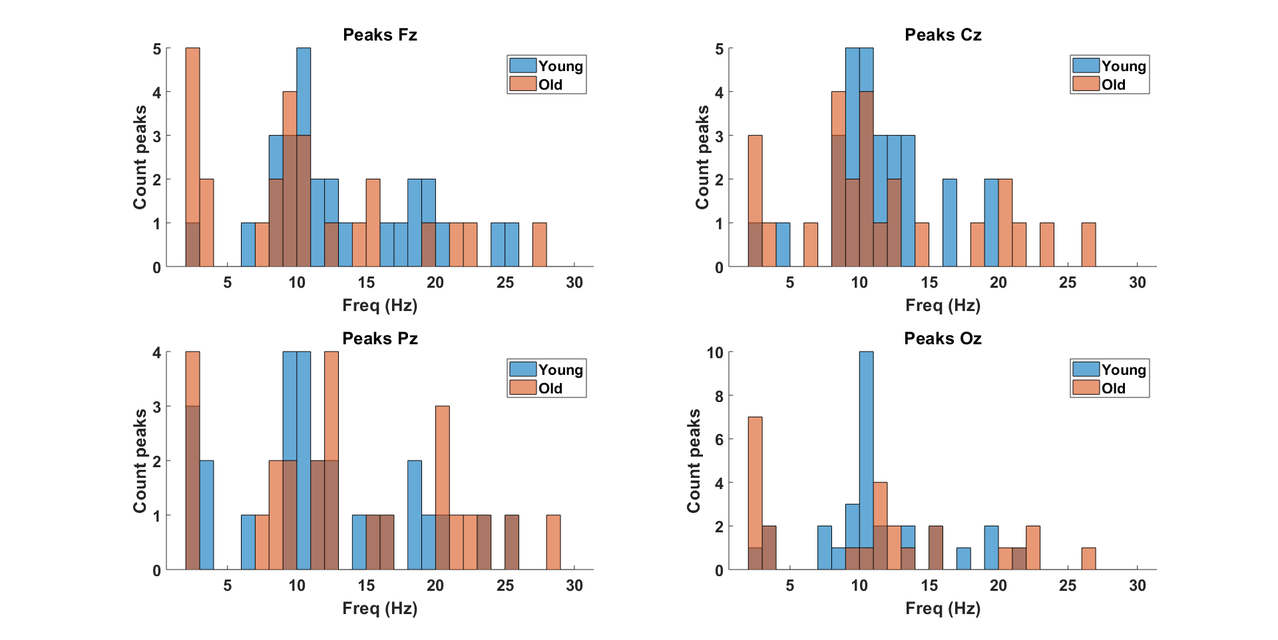
OLD SETTINGS
Notes:
Proportion of individuals with a peak in the alpha range and the theta/delta range (see all_detectedpeaks variable) – DONE (see slide 18)

Slide 24
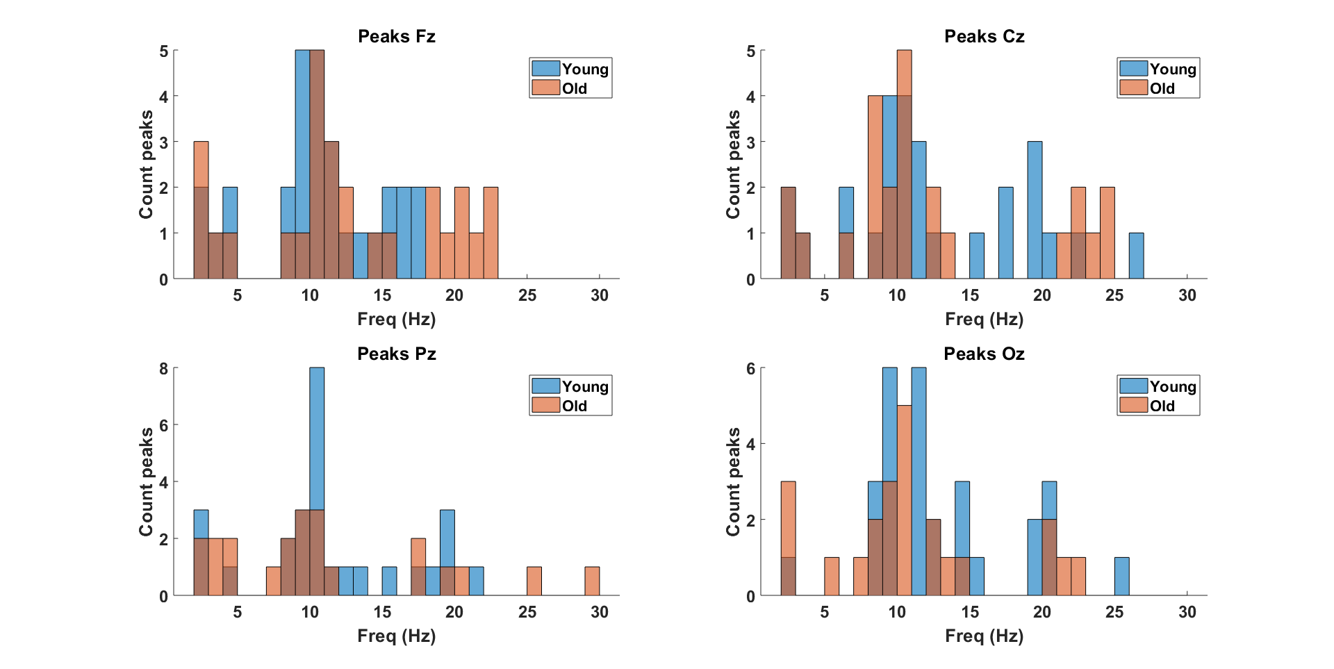
NEW SETTINGS

Slide 25
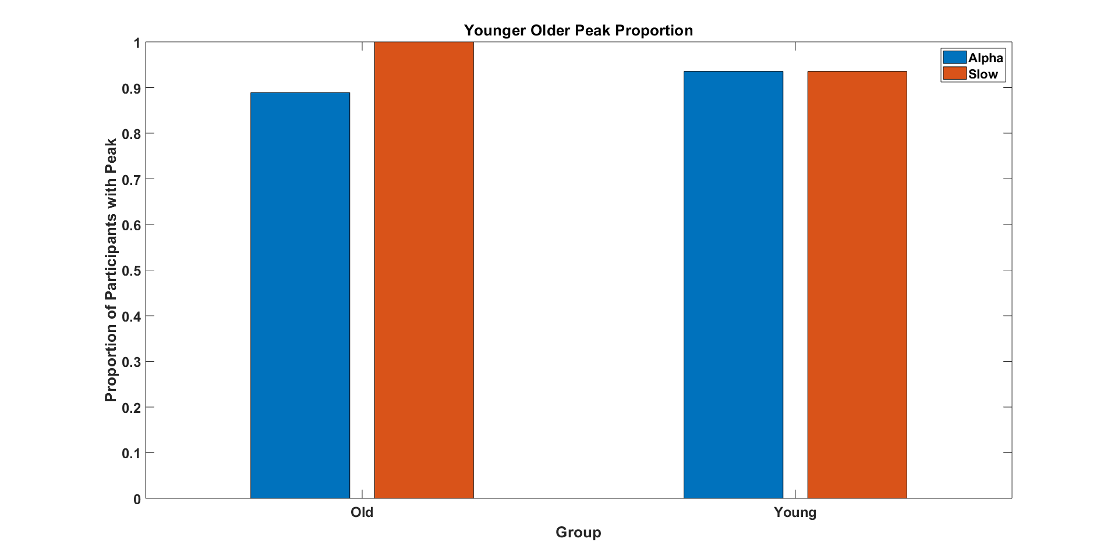

Slide 26
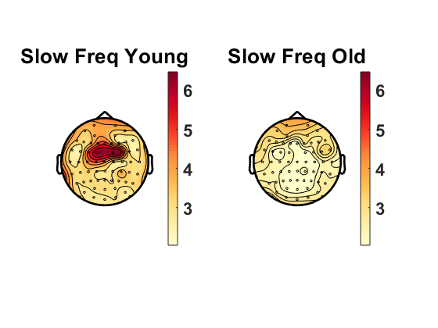
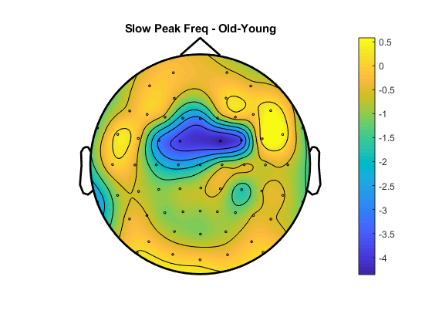
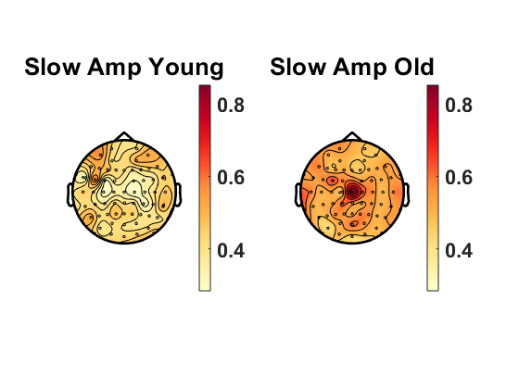
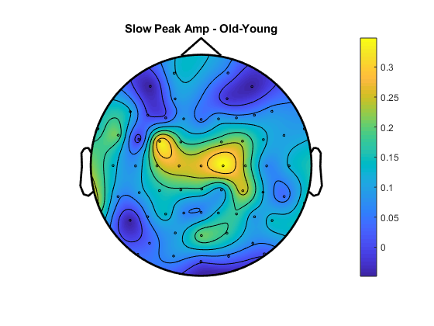
Slow Peak Frequency – Younger 90% vs Older 90%
Slow Peak Amplitude – Younger 90% vs Older 90%
Notes:
Same scale if possible – DONE
Pull delta & theta together - DONE

Slide 27
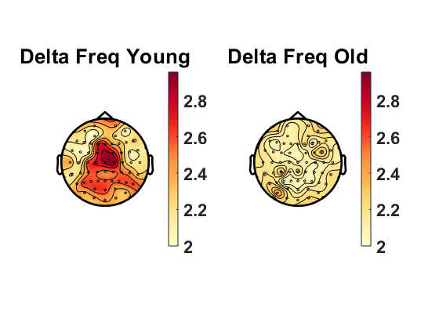



Delta Peak Frequency – Younger 90% vs Older 90%
Delta Peak Amplitude – Younger 90% vs Older 90%
Notes:
Same scale if possible

Slide 28


Delta Peak Frequency – Younger 90% vs Older 90%
OLD CUTOFFS
Delta Peak Amplitude – Younger 90% vs Older 90%

Slide 29




Theta Peak Frequency – Younger 90% vs Older 90%
Theta Peak Amplitude – Younger 90% vs Older 90%

Slide 30


Theta Peak Frequency – Younger 90% vs Older 90%
OLD CUTOFFS
Theta Peak Amplitude – Younger 90% vs Older 90%

Slide 31




Alpha Peak Frequency – Younger 90% vs Older 90%
Alpha Peak Amplitude – Younger 90% vs Older 90%

Slide 32


Alpha Peak Frequency – Younger 90% vs Older 90%
OLD CUTOFFS
Alpha Peak Amplitude – Younger 90% vs Older 90%

Slide 33




Beta Peak Frequency – Younger 90% vs Older 90%
Old-Young
Beta Peak Amplitude – Younger 90% vs Older 90%
Old-Young

Slide 34


Beta Peak Frequency – Younger 90% vs Older 90%
OLD CUTOFFS
Beta Peak Amplitude – Younger 90% vs Older 90%

Slide 35

Young 90% Coherence

Slide 36

Old 90% Coherence

Slide 37

Difference TF – Young-Old

Slide 38

Young 90% Coherence

Slide 39

Old 90% Coherence

Slide 40

Difference TF – Young-Old

Slide 41

Young 90% Coherence

Slide 42

Old 90% Coherence

Slide 43

Difference TF – Young-Old

Slide 44





Slide 45





Slide 46





Slide 47





Slide 48





Slide 49





Slide 50





Slide 51





Slide 52




Slide 53





Slide 54





Slide 55





Slide 56





Slide 57





Slide 58





Slide 59





Slide 60





Slide 61





Slide 62





Slide 63





